Slide 1
Product demand predicting with machine learning

Slide 2
synopsis
INTRODUCTION
DEFINING THE PROBLEM
DATA COLLECTION AND DATA PROCESSING
MODEL SELECTION AND MODEL TRAINING
FINE-TUNING AND PREDICTION
DOCUMENTATION
CONCLUSION

Slide 3
introduction
In this presentation I was explained that “how I was cooking the project
PRODUCT DEMAND PREDICTING WITH MACHINE LEARNING ” by myself.
And the overall steps which are taken by me was presented here .We will
see briefly about the project in this presentation.

Slide 4
Defining the problem
First of all, I clearly outline the problem which that I want to solve. In this
case , I could create a machine learning model for predicting the
demand of some product . Here I was used AGENDA and KANBAN
softwares to outline the main sections of the project like data collection
and data processing .

Slide 5
Data collection and data processing
I was used agenda and kanban softwares to process the data which
was given. Here the data cleaning and data processing were done by the
mentioned above softwares. After completing the data processing , the
processed data was integrated into my github account to further
Process for predicting the demand of the products .

Slide 6
Data collection and data processing
I was used agenda and kanban softwares to process the data which
was given. Here the data cleaning and data processing were done by the
mentioned above softwares. After completing the data processing , the
processed data was integrated into my github account to further
Process for predicting the demand of the products .

Slide 7
Fine-tuning and prediction
In this phase ,I refined my machine learning model based on the
evaluation results of my model. I refined this model by the tweaking
feature , adjusting parameters and trying different algorithms. By the
respect of the given datasets , I make my model to predict the demand
of a product. Then I monitor my machine learning model for the future
optimizations in that model.

Slide 8
program
import pandas as pd
import numpy as np
import plotly.express as px
import seaborn as sns
import matplotlib.pyplot as plt
from sklearn.model_selection import train_test_split
from sklearn.tree import DecisionTreeRegressor
data.isnull().sum()
data = data.dropna()
fig = px.scatter(data, x="Units Sold", y="Total Price",
size='Units Sold’)
fig.show()

Slide 9
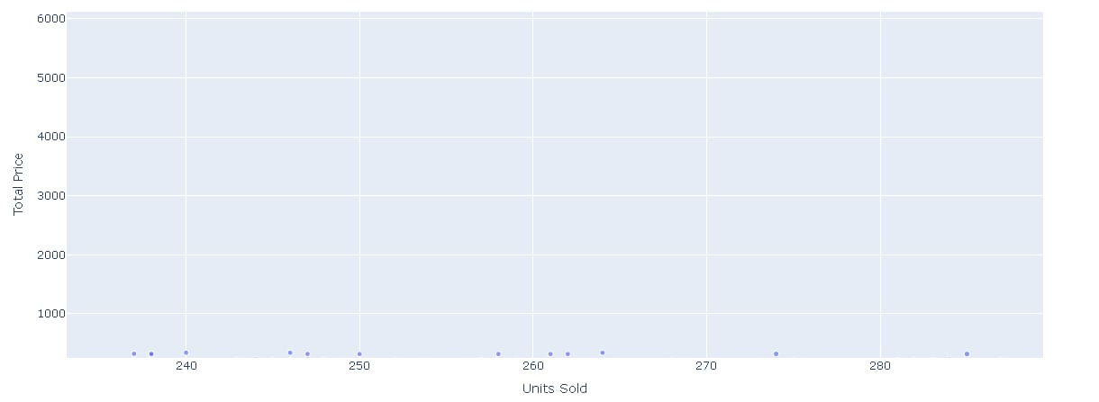
output

Slide 10
print(data.corr())
correlations = data.corr(method='pearson’)
plt.figure(figsize=(15, 12))
sns.heatmap(correlations, cmap="coolwarm", annot=True)
plt.show()
x = data[["Total Price", "Base Price"]]
y = data["Units Sold"]
xtrain, xtest, ytrain, ytest = train_test_split(x, y, test_size=0.2, random_state=42)
from sklearn.tree import DecisionTreeRegressor
model = DecisionTreeRegressor()
model.fit(xtrain, ytrain)
#features = [["Total Price", "Base Price"]]
features = np.array([[133.00, 140.00]])
model.predict(features)

Slide 11
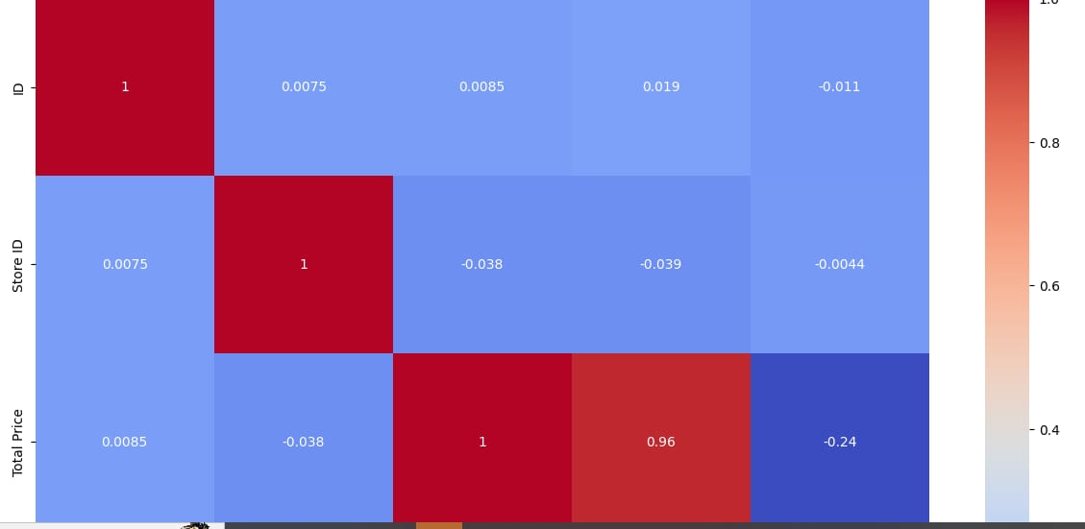
output

Slide 12
documentation
I was documented the whole process of creating the machine learning
model for predicting demand of some products as a pdf and ppt format
for the future reference of its. This is the final phase of my project
product demand predicting with machine learning.

Slide 13
conclusion
I hope that ,I was briefly explained my project , product demand
predicting with machine learning by this presentation. This product
demand predicting is be an important thing in future by predicting
the value of the product.

Slide 14
conclusion
I hope that ,I was briefly explained my project , product demand
predicting with machine learning by this presentation. This product
demand predicting is be an important thing in future by predicting
the value of the product.

